Slide 1
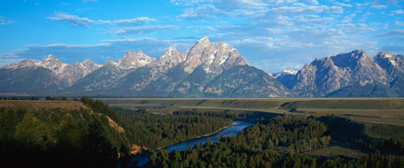
Assessment of the contributions to visibility impairment in the western us and effects of new guidance f0r tracking progress
Alternative title slide
Ralph Morris and Ou Nopmongcol, Ramboll Environ
Tom Moore, WESTAR/WRAP
Control #42
Presented at A&WMA Visibility Conference
Jackson Hole, Wyoming
September 27-30, 2016
Notes:
Alternative title slide. Image size: 8 cm x 25,4 cm or 302 x 960 pixels

Slide 2
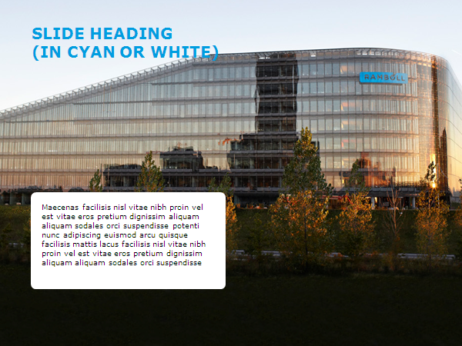
Content
WAQS 2011 Photochemical Grid Model (PGM) Modeling
CAMx/CMAQ 2011 PGM Modeling Databases
2025 Future-Year Modeling
WAQS 2011 PSAT PM Source Apportionment Modeling
Used to Define Controllable vs. Uncontrollable components of extinction in IMPROVE data
New PSAT W20% and PSAT Most Impaired Days visibility metric
2064 Natural Conditions
Use CAMx USB (no U.S. anthropogenic) simulations
Illustrative Comparison of Four Glide Path/Model Results
W20%; EPA Most Impaired; PSAT W20% and PSAT Most Impaired
Full slide image with white fact box
Notes:
Full slide image with white fact box

Slide 3
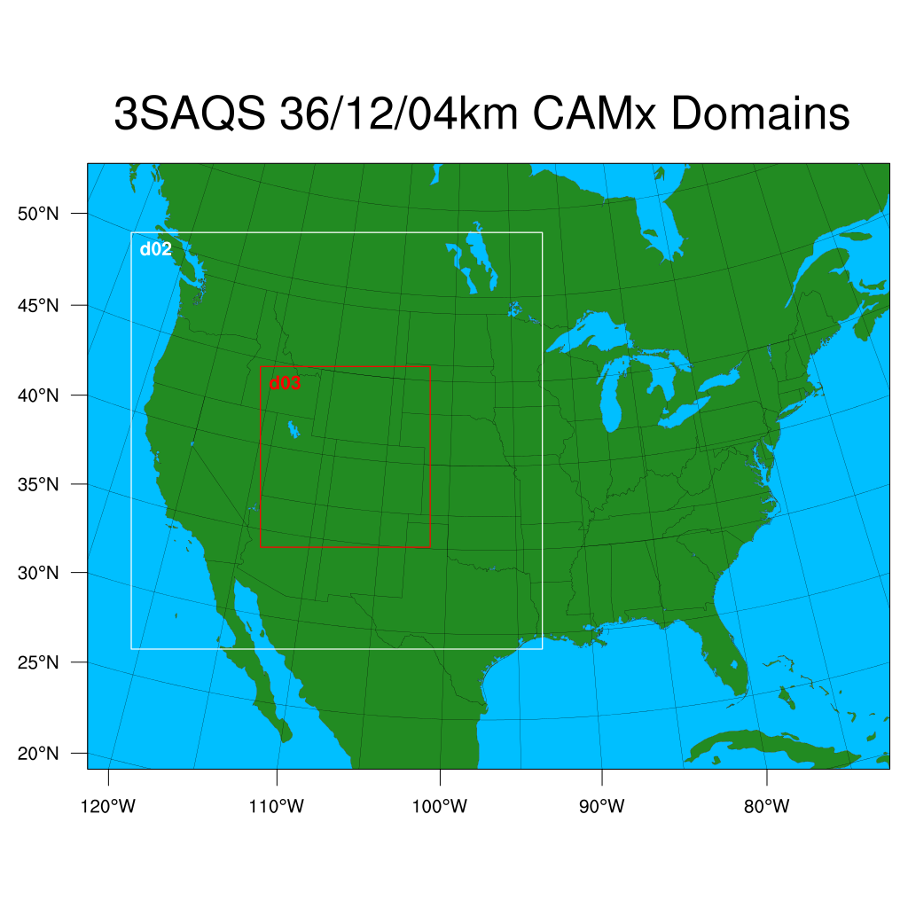
WAQS 2011 36/12/4 km PGM Database
WAQS CAMx 2001 Database
36/12/4 km Domain
2011 Base Case and MPE
2025 Future Modeling
2011 OSAT Ozone and PSAT PM Source Apportionment Modeling
Process for visibility extinction at IMPROVE sites
Use to define 2011 Controllable vs. Uncontrollable visibility extinction in IMPROVE data
2011 Clean U.S. Background (USB)
Transfer database to Intermountain West Data Warehouse (IWDW)

Slide 4
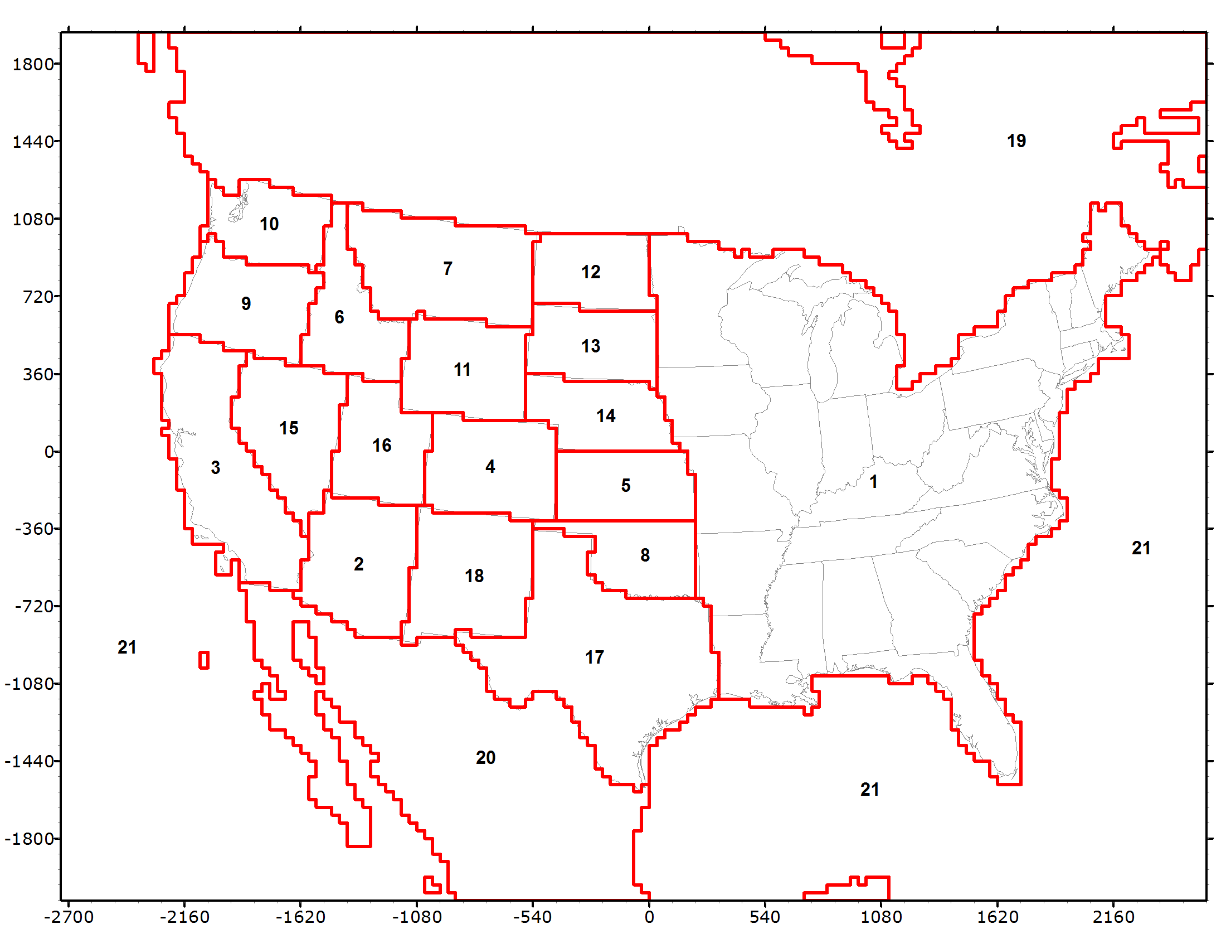
WAQS 2011 State-Specific Source Apportionment Visibility Analysis
PSAT PM Source Apportionment
21 Geographic Regions
17 W. States + EUSA
Mex, Can, Off-shore
Five Source Categories
Natural
Bio, LNOx, SS, WBD
Wildfire
Prescribed Burns
Agricultural Burning
Anthropogenic
107 Total Source Groups (21 x 5 + 2 for IC/BC)

Slide 5
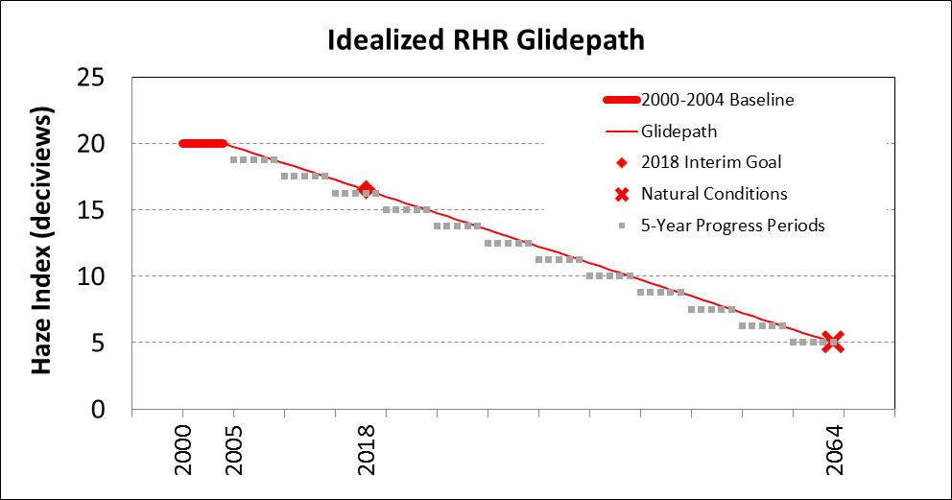
Use WAQS PM Source Apportionment data in URP Glide Path Evaluation
How to define 2000-2004 Baseline based on measured IMPROVE?
W20%; EPA Most Impaired; PSAT W20%; PSAT Most Impaired
How to define 2064 Natural Conditions?
NCII; EPA guidance; PSAT Uncontrollable; US Background Runs
Baseline
Natural
Conditions

Slide 6
WAQS 2011 Visibility Analysis
Use PSAT PM Source Apportionment results to separate IMPROVE PM data into Controllable and Uncontrollable Sources for each Day
Controllable Sources
U.S. Anthropogenic Emissions
Uncontrollable Sources:
Natural Emissions
Biogenic, Lightning NO_{X}, WBD, Sea Salt, Ocean DMS
Open Land Fires
Wild fires, Prescribed Burns and Agricultural Burning
International Transport
Mexico and Canada in CONUS Domain
MOZART GCM CONUS Boundary Conditions (BCs)

Slide 7
2011 Canyonlands IMPROVE and PSAT 24-hour visibility extinction

Slide 8
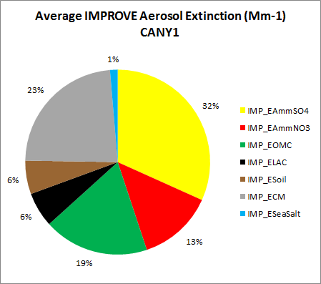
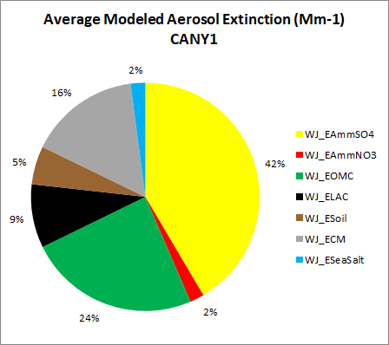
Species contributions to 2011 annual extinction at canyonlands (IMP DAYS)
2011 IMPROVE
(10 Mm⁻¹)
2011 CAMx
(9 Mm⁻¹)

Slide 9
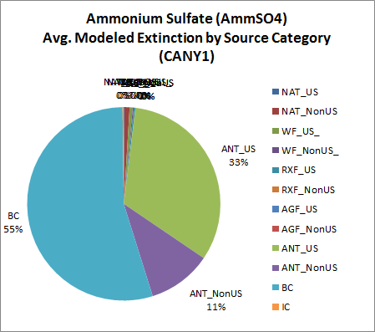
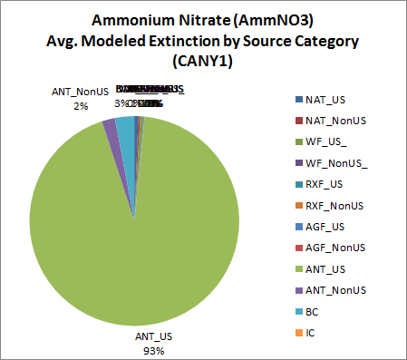
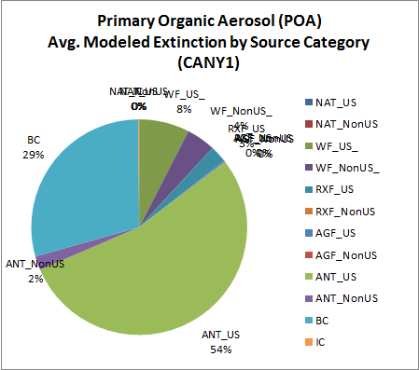
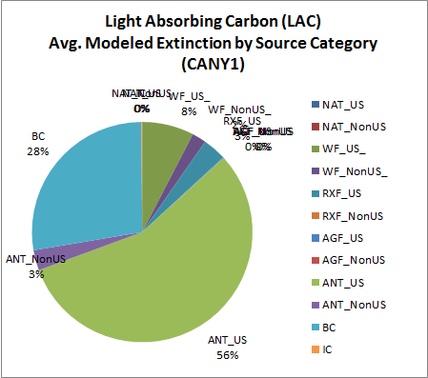
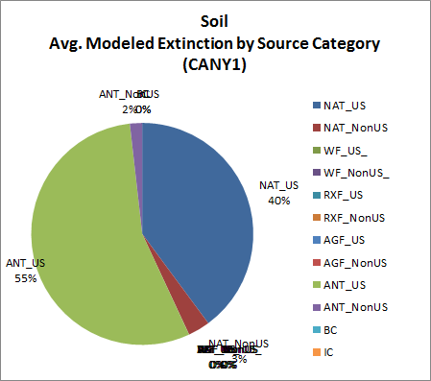
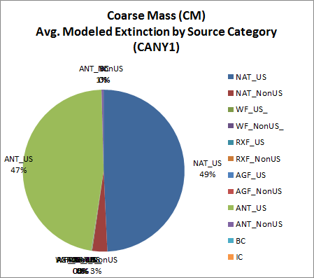
2011 PSAT controllable (ANT_US) vs. unControllable (NAT; ANT_NonUS; BC; Fires)

Slide 10
Canyonlands -- 2011 PSAT Separate improve extinction into controllable/uncontrollable

Slide 11
Fraction of AmmNO3 and AmmSO4 that is controllable vs. uncontrollable at canyonlands using PSAT

Slide 12
Uniform Rate of Progress (URP) Glide Path sensitivity Analysis
Analysis of Opportunity: Illustrate effects of different approaches for defining Baseline worst/most impaired days and Natural Conditions endpoints on modeled URP analysis
Not an actual URP Glide Path analysis, for illustrative purposes only
Use 2011 as Baseline Period
Since have IMPROVE and CAMx PSAT modeling results
Use 2064 as Natural Condition Year
Use WAQS CAMx 2011 and 2025 modeling results to make 2025 visibility projections for comparison with Glide Path
Species-specific Relative Response Factors (RRFs = Model₂₀₂₅/Model₂₀₁₁) based on different days in Baseline 20% worst/most impaired visibility days

Slide 13
Four urp glide path/projection examples 2011 – 2025 – 2064
W20% days approach as used in first RHR implementation period (2000-2018) RHR SIPs
Baseline = 2011 raw 2011 IMPROVE data W20% days
2064 Natural Conditions = NC II
EPA 2016 draft guidance approach using EPA Most Impaired Days
Baseline = EPA Most Impaired Days using screened 2011 IMPROVE
2064 Natural Conditions = EPA Natural Conditions
Two PSAT approaches: PSAT W20% and PSAT Most Impaired
IMPROVE data screened to replace OMC/OA, PMF and PMC extinction values that are > 5 x Median with Median values
Baseline = PSAT W20% Days or PSAT Most Impaired Days
2064 Natural Conditions = CAMx USB (no US Anthro) simulation averaged across PSAT W20% or PSAT Most Impaired days

Slide 14
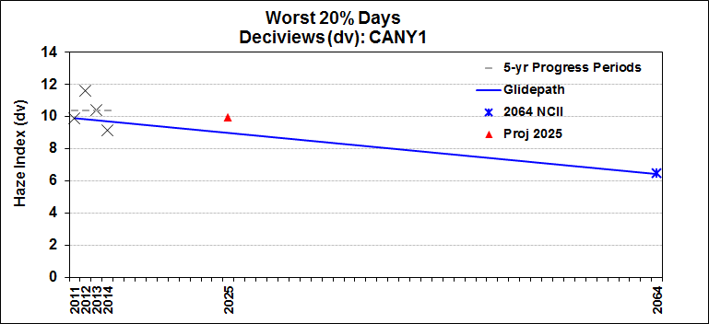
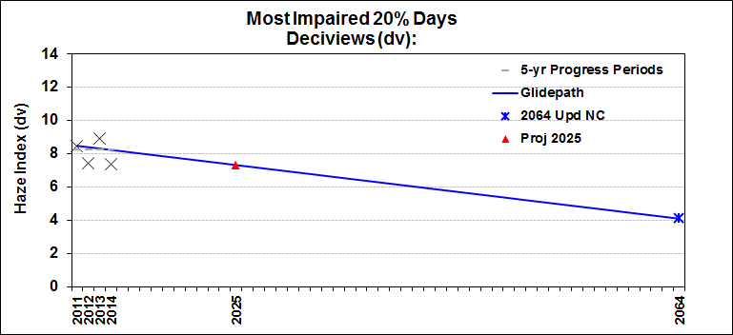
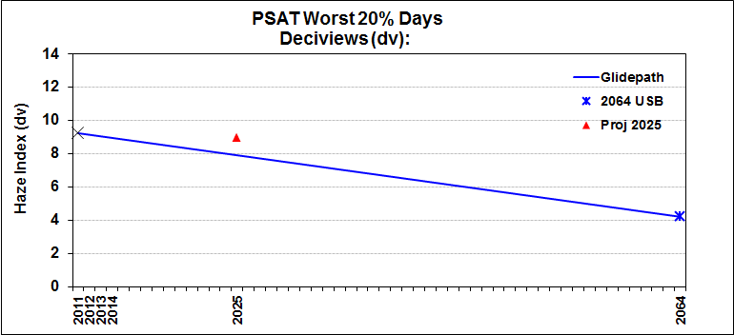
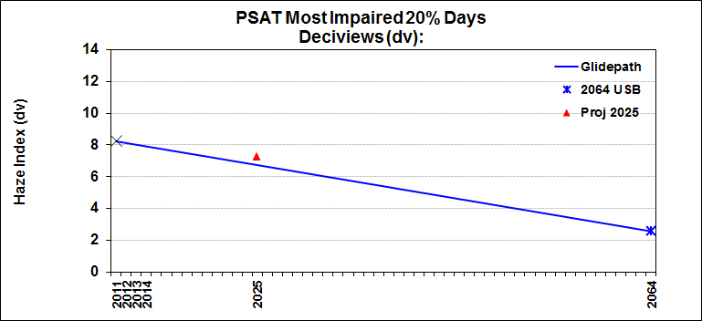
Example canyonlands Glide Paths and 2025 projections using 4 approaches
W20%
EPA Most Impaired
PSAT W20%
PSAT Most Impaired

Slide 15
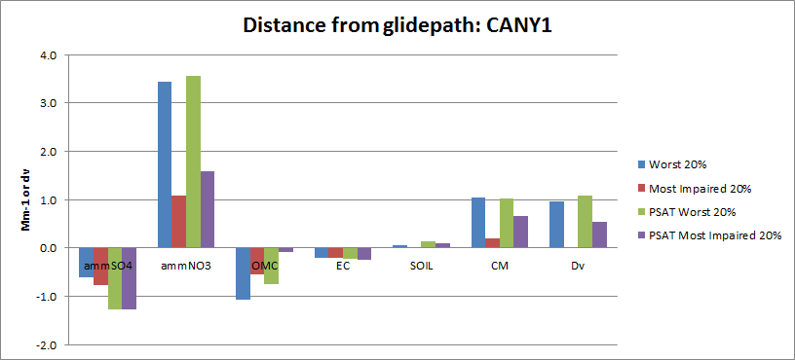
Canyonlands: Difference (mm⁻¹) between 2025 model and 2025 URP glide path using four methods

Slide 16
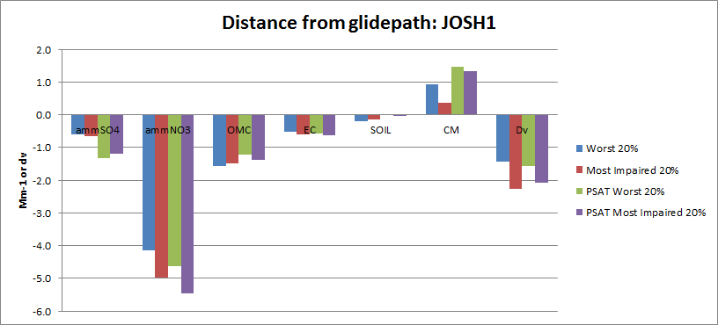
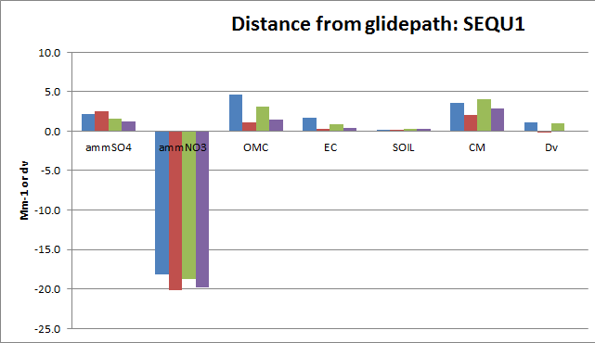
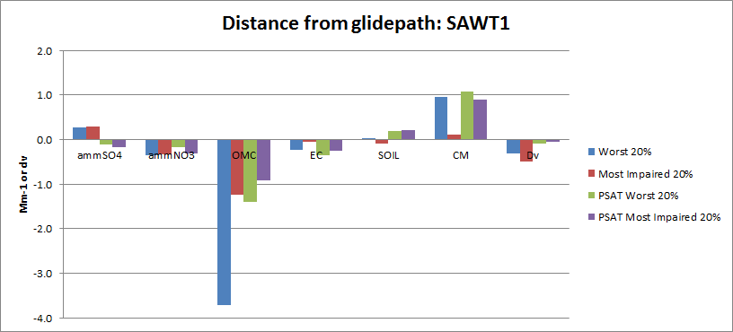
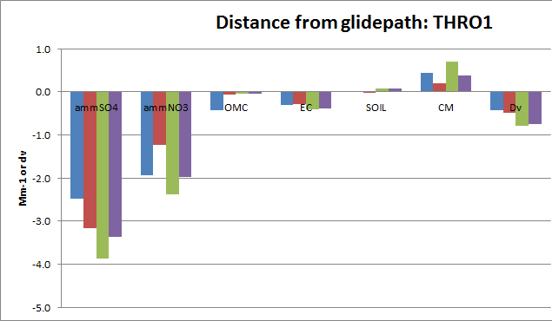
Comparison of 2025 modeled/glide path at 4 sites using four methods
Joshua Tree, CA
Sequoia, CA
Sawtooth, ID
Theodore Roosevelt, ND

Slide 17
Preliminary evaluation of new visibility metrics for demonstration progress toward visibility goals
All agree that W20% days metric used in first implementation period for RHR has serious flaws
W20% includes high wildfire/WBD events not man-made impairment
New EPA Most Impaired metric based on statistical analysis of IMPROVE data better than W20%, but provides imprecise definition of impairment:
95th percentile screening/replacement doesn’t screen all wildfire/WBD events at sites with high frequency occurrence and screens too many events at sites with low frequency occurrence
Potential inconsistencies with modeled RRFs used for FY projections
PSAT Source Apportionment has a very precise definition of impairment, but may be not accurate
Inconsistencies between IMPROVE and PSAT source contributions can produce inaccuracies

Slide 18
Preliminary evaluation of new visibility metrics for demonstration progress toward visibility goals
Further analysis needed, some observations so far:
All Approaches: IMPROVE high wildfire days that are part of Baseline that have no or low modeled fire contribution would be reduced by the modeled RRFs when should stay constant
In actuality, at least for the WAQS 2011 PSAT run using the PMDETAIL fire inventory, PSAT captured major fire days at IMPROVE sites fairly well
EPA Most Impaired metric includes wildfire impacts at IMPROVE sites with high frequency fire impacts
95th percentile threshold could be adjusted down (up) for those sites with high (low) frequency fire contributions
Need more study of the results to understand effects from:
(1) Baseline; (2) Natural Conditions; (3) Model RRFs; and (4) Inconsistencies between modeling results and IMPROVE data

Slide 19
Thank you
End slide
Notes:
Endslide

